Slide 1
HARVEST HELPERS USING
AI APPROACHES TO OPTIMIZE
NUTRIENT USAGE
Presented by :
Thrisha M (210701292)
Vamsee Raj M R (210701300)
Yamini H (210701320)
Under the Guidance
Dr . Shanmugam M.E.,Ph.D.,
Associate Professor

Slide 2
ABSTRACT
Fertilizer use is typically under the limited control of farmers. For the farmers to achieve higher yields and reduce fertilizer loss, competent guidance is required for the best use of these fertilizers. Additionally, there is a connection between rainfall volume and nutrient loss for various fertilizer applications after each rainfall event. Rainfall that is moderate and falls at the right moment can help nutrients penetrate the soil's rooting zone and dissolve dry fertilizer. However, too much rain can increase the possibility of runoff and the pace at which nutrients like nitrogen (N) which is quintessential, phosphorus (P), and potassium (K) which are crucial, manganese (Mn), and boron (B) that are present in the soil. This research presents nutrient recommendations using an updated iteration of the random forest algorithm which is based on time-series data to forecast the required quantity of nutrients for various crops by examining rainfall patterns and crop fertility. The method suggested in this study, comes in handy for improving soil fertility by providing nutrients recommendations for optimum conditions for crop growth and reducing leaching and runoff potential.

Slide 3
PROBLEM STATEMENT
The challenge entails inconsistent and improper fertilizer use significantly impacts crop yields, soil health, and farmers' economic returns. This project aims to develop a machine learning-based system to provide precise fertilization recommendations, optimizing nutrient use and timing. Utilizing a random forest algorithm with k-fold cross-validation, the model analyzes historical crop fertility and rainfall data. By inputting crop type and location, farmers receive customized nutrient and application timing advice. The web platform, built with Flask Python, ensures accessibility for farmers, promoting sustainable practices and enhancing agricultural productivity, thus supporting national economic growth in India's agriculture sector.

Slide 4
Literature Review
Ref No. | Year | Title | Author’s Name | Journal | Description
1. | 2018 | Prediction of Crop Fertilizer Consumption | Krutika Hampannavar, Vijay Bhajantri Shashikumar G. Totad | IEEE, DOI:10.1109/ICCUBEA.2018.8697827 | Prediction of fertilizer consumption can prevent the toxicity and deficiency in plants to certain extent and this can help farmers to get proper yield without much wastage.
2. | 2018 | Fuzzy decision support system for improving the crop productivity and efficient use of fertilizers | G. Prabakaran,D. Vaithiyanathan, Madhavi Ganesan | Computers and Electronics in Agriculture ,ISSN : 0168-1699 (Elsevier) | This paper explores the process of using fuzzy logic systems to reduce fertilizer consumption and improve crop productivity.
3. | 2018 | Data Mining Techniques for Crop Yield Prediction | Shital Bhojani Nirav Bhatt | Computers and Electronics in Agriculture, ISSN: 0168-1699 (Elsevier) | It's a difﬁcult task to predict crop yield due to stochastic rain fall pattern and also variation in temperature. So we can apply different data mining techniques for crop yield predication and can produce an efﬁcient algorithm for crop classiﬁcation for better.

Slide 5
Literature Review
Ref No. | Year | Title | Author’s Name | Journal | Description
4. | 2019 | Estimation of NPK requirements for rice production in diverse Chinese environments under optimal fertilization rates | Yulong Yin, Hao Ying Huifang Zheng ,Qingsong Zhang ,Yanfang Xue, Zhenling Cui | Agricultural and Forest Meteorology, ISSN : 0168-1923 (Elsevier) | Objectives of this study were to evaluate the relationship between nutrient requirements and climates or soil chemical properties.
5. | 2020 | Rainfall intensification increases nitrate leaching from tilled but not no-till cropping systems in the U.S. Midwest | Laura J.T. Hess Eve-Lyn S. Hinckley G. Philip Robertson Pamela A. Matson | Agriculture, Ecosystems & Environment, ISSN : 0167-8809 (Elsevier) | Rainfall intensification may exacerbate leaching losses of reactive N from cropping systems, and that no-till management may buffer against these losses.
6. | 2020 | Crop Yield Prediction Based on Indian Agriculture using Machine Learning | Potnuru Sai Nishant Pinapa Sai Venkat Bollu Lakshmi Avinash B. Jabber | 2020 International Conference for Emerging Technology (INCET) | This paper predicts the yield of almost all kinds of crops in India. This script makes novel by usage of simple parameters like state, district, season, area and the user can predict the yield of the crop in which year he or she wants to.

Slide 6
Literature Review
Ref No. | Year | Title | Author’s Name | Journal | Description
7. | 2020 | Cropping systems in agriculture and their impact on soil health | TonyYang, Kadambot H.M. Siddique, Kui Liu | Global Ecology and Conservation, ISSN: 2351-9894 (Elsevier) | Significant achievements, including refine content of soil health and the development of new evaluation standards for ‘soil health and quality’.
8. | 2020 | Would fertilization history render the soil microbial communities and their activities more resistant to rainfall fluctuations? | János Kátai Ágnes Oláh Zsuposné Magdolna Tállai Tarek Alshaal | Ecotoxicology and Environmental Safety, ISSN: 0147-6513 (Elsevier) | This paper aims to study the intrinsic changes in the composition of soil populations and their functions due to the interaction between long-term fertilization and rainfall fluctuations, seeing whether fertilization history would render the soil microbial communities and their activities more resistant to water stress or not.
9. | 2021 | A nutrient recommendation system for soil fertilization based on Evolutionary Computation. | Usman Ahmed Jerry Chun-Wei Lin Gautam Srivastava Youcef Djenouri | Computers and Electronics in Agriculture, ISSN: 0168-1699 (Elsevier)) | This paper develops a model that enables efficient exploration of correct usage of nutrients (such as N, P and K) for developing a knowledge-based system for the ICT (Information and Communication Technology) environment.

Slide 7
Literature Review
Ref No. | Year | Title | Author’s Name | Journal | Description
10. | 2021 | Controlled traffic farming effects on productivity of grain sorghum, rainfall and fertiliser nitrogen use efficiency | A.Hussein Diogenes L. Antille Shreevatsa Kodur GuangnanChen Jeff N.Tullberg | Journal of Agriculture and Food Research | Enhanced efficiency fertilizers cannot compensate for other stresses caused by compaction.
11. | 2021 | Optimized fertilizer recommendation method for nitrate residue control in a wheat–maize double cropping system in dryland farming | Zujiao Shi, Donghua Liu, Miao Liu, Muhammad Bilal Hafeez, Pengfei Wen, Xiaoli Wang, Rui Wang, Xudong Zhang, Jun Li | Field Crops Research ISSN: 0378-4290 (Elsevier) | To optimize the fertilizer recommendation method and reduce nitrate residue levels, this paper establishes the relationships between crop yield, nitrogen requirement, and nitrate residue level under combined N and P fertilizer application.
12. | 2021 | Analysis of agricultural crop yield prediction using statistical techniques of machine learning | Janmejay Pant, R.P. Pant, Manoj Kumar Singh, Devesh Pratap Singh, Himanshu Pant | Materials Today: Proceedings, ISSN: 2214-7853 (Elsevier) | This paper suggests the use of Machine Learning techniques to create a trained model for detecting patterns in data, which we then used to predict crop yields. The application of machine learning to the prediction of four of India's most cultivated yields is considered in this study. Maize, potatoes, rice (paddy), and wheat are among these crops.

Slide 8
Literature Review
Ref No. | Year | Title | Author’s Name | Journal | Description
13. | 2021 | Prediction of the production of crops with respect to rainfall. | Benny Antony | Environmental Research, ISSN: 0013-9351 (Elsevier) | This paper predicts the production of crops as a function of rainfall. This is implemented by generating a rough overview of how the production is based on rainfall and how much can a specific crop production for the amount of rainfall it receives. The proposed method of evaluation is better than other existing methods of evaluation as it evaluates all the regression techniques.
14. | 2021 | Factors affecting agriculture and estimation of crop yield using supervised learning algorithms | Akash Manish Lad, K. Mani Bharathi, B. Akash Saravanan, R. Karthik | Materials Today: Proceedings, ISSN: 2214-7853 (Elsevier) | Comprehensive method developed to estimate crop sustainability using supervised algorithms that increase crop yields, reduce manual labor, time spent on various agricultural activities and plant recommendations based on certain soil parameters.
15. | 2021 | Precision agriculture using IoT data analytics and machine learning | Raves Akhtar, Shabbir Ahmad Sofi | Journal of King Saud University - Computer and Information Sciences,ISSN: 1319-1578(Elsevier) | This paper proposes an apple disease prediction model in apple orchards in Kashmir Valley using data analysis and machine learning in an IoT system. The paper discusses the challenges faced when integrating these technologies into traditional agricultural approaches.

Slide 9
Literature Review
Ref No. | Year | Title | Author’s Name | Journal | Description
16. | 2021 | Farmers' risk preference and fertilizer use | Fang-binQIAOJi-kunHUANG | Journal of Integrative Agriculture | This study examines the role of farmers' risk attitudes toward fertilizer use in cotton production.
17. | 2022 | Untangling the effect of soil quality on rice productivity under a 16-years long-term fertilizer experiment using conditional random forest | Saheed Garnaik, Prasanna Kumar Samant, Mitali Mandal, Tushar Ranjan Mohanty, Sanat Kumar Dwibedi, Ranjan Kumar Patra, Kiran Kumar Mohapatra, R.H. Wanjari, Debadatta Sethi, Dipaka Ranjan Sena, Tek Bahadur Sapkota, Jagmohan Nayak, Sridhar Patra, Chiter Mal Parihar, Hari Sankar Nayak. | Computers and Electronics in Agriculture, ISSN: 0168-1699(Elsevier) | The study demonstrated how interpretable machine learning techniques can be used in long-term fertilizer experiments to produce the most meaningful information, and that these techniques can be used in other similar long-term experiments.
18. | 2022 | Agricultural decision system based on advanced machine learning models for yield prediction: Case of East African countries | Rubby Aworka, Lontsi Saadio Cedric, Wilfried Yves Hamilton Adoni, Jérémie Thouakesseh Zoueu, Franck Kalala Mutombo, Charles Lebon Mberi Kimpolo, Tarik Nahhal, Moez Krichen | Smart Agricultural Technology, ISSN: 2772-3755 (Elsevier) | Crop Random Forest, Crop Gradient Boosting Machine, and Crop Support Vector Machine are three crop prediction models proposed in this paper. The paper makes use of advanced machine learning models to develop a decision system based on climate data, crop production data, and pesticide data.

Slide 10
Literature Review
Ref No. | Year | Title | Author’s Name | Journal | Description
19. | 2022 | Smart farming using Machine Learning and Deep Learning techniques | Senthil Kumar Swami Durai, Mary Divya Shamili | Decision Analytics Journal, ISSN: 2772-6622(Elsevier) | The purpose of this paper is to help an individual farm be efficient and thus achieve high yield at a low cost. It also helps to predict the total costs required for growth. It will help one to plan ahead Pre-cultivation activities lead to an integrated solution in agriculture.
20. | 2022 | Improving the prediction accuracy of soil nutrient classification by optimizing extreme learning machine parameters | M.S. Suchithra, Maya L. Pai | Information Processing in Agriculture, ISSN: 2214-3173 (Elsevier) | This paper suggests solutions to the classification problems of soil nutrient which are solved using the fast learning classification technique known as Extreme Learning Machine (ELM) with different activation functions.

Slide 11
EXISTING SYSTEM
Existing system approaches take a holistic view of crop production by considering various factors such as soil health, pest management, water use efficiency, and nutrient optimization. Many governments and agricultural extension agencies offer educational programs, workshops, and resources to help farmers adopt sustainable nutrient management practices, often including soil testing services, nutrient management training, and incentives for implementing conservation practices. These systems utilize various technologies like GPS, sensors, drones, and satellite imagery to gather data on soil properties, crop health, and environmental conditions. This data is then used to create prescription maps for precise fertilizer application, minimizing waste and environmental impact. Nutrient Management Plans (NMPs) are comprehensive strategies developed for farms to optimize nutrient use while minimizing environmental impact. They involve soil testing, crop nutrient requirement calculations, and recommendations for fertilizer application rates and timing based on scientific principles. Decision Support System (DSS) tools provide farmers with real-time or predictive information on weather conditions, soil moisture levels, crop growth stages, and nutrient requirements, helping farmers make informed decisions about fertilizer application and other agronomic practices.

Slide 12
PROPOSED SYSTEM
The proposed system aims to develop a web-based application providing precise fertilizer recommendations to farmers, optimizing nutrient use and timing to enhance crop yields, soil health, and economic returns. Using the Random Forest algorithm with k-fold cross-validation, the system analyzes historical soil nutrients, crop needs, and weather data. Real-time weather data integration via a Weather API ensures current recommendations. Key components include data preparation (handling historical data and key feature selection), a machine learning model (Random Forest Regression for nutrient prediction, validated with metrics like MAE and MSE), a user interface (for inputting crop type, location, and weather conditions), and recommendation modules (optimal fertilization timing and NPK ratio estimation). The output module displays nutrient recommendations and a 7-day rainfall forecast. User testing and feedback will refine the system, ensuring practical utility for farmers and continuous improvement. This system supports sustainable agricultural practices and enhances India's agricultural productivity.

Slide 13
METHODOLOGY
In this study, a predictive model for the nutrients required for crops was obtained using random forest. Random Forest Regression represents the model with K-Fold Cross Validation technique and the model with acceptable accuracy for the prediction is then obtained. A total of 7 features have been used to evaluate the algorithm. The algorithm requires input from the user (such as location and cropping). The location is fed to the Weather API which will return certain characteristics (e.g. temperature, humidity, rainfall) and if there is a possibility of heavy rainfall, a precautionary message is displayed to the user, otherwise the proposed algorithm is followed.

Slide 14
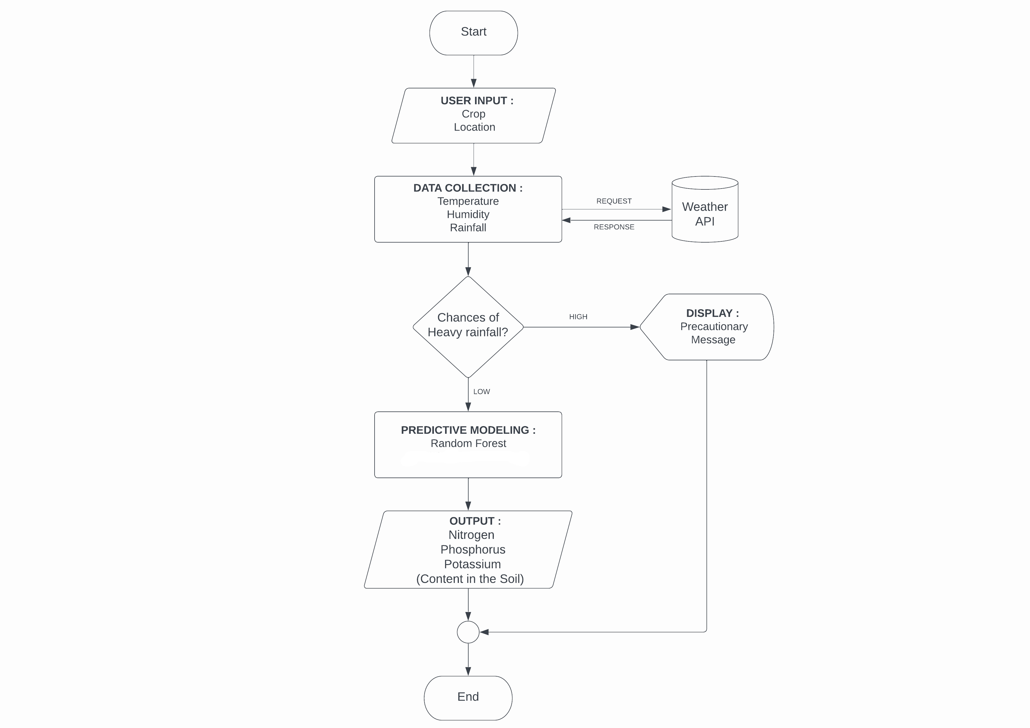
IMPLEMENTATION MODEL
Flowchart :

Slide 15
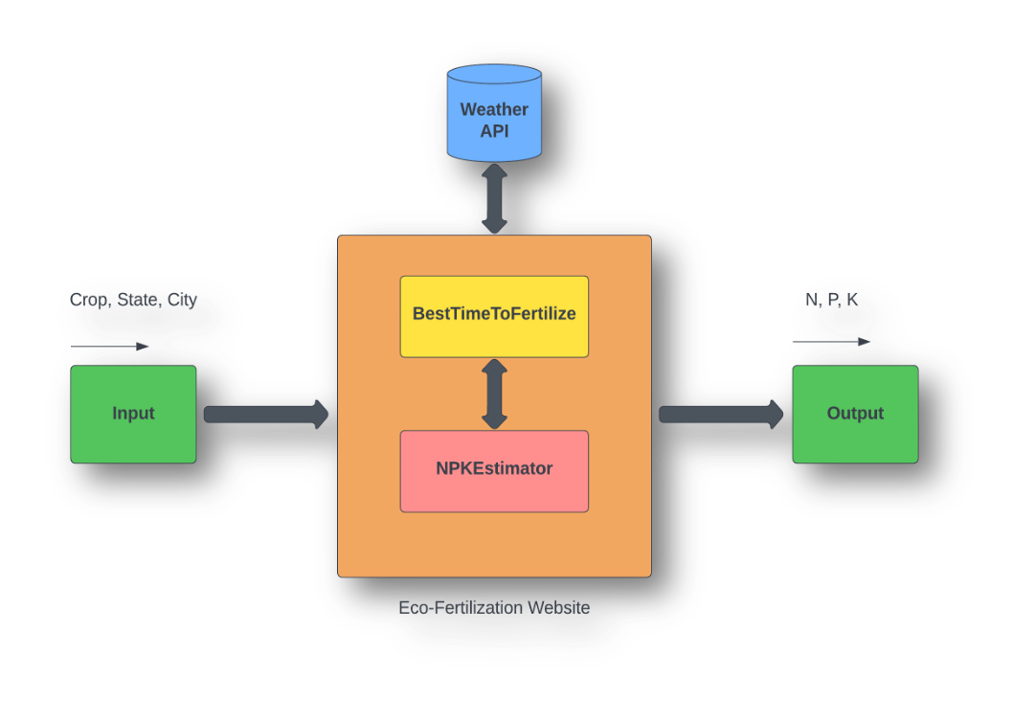
IMPLEMENTATION MODEL
System architecture is a conceptual model that defines the structure and behavior of the system. It comprises of the system components and the relationships describing how they work together to implement the overall system. The Figure shows the system’s architecture and the various components added to them.

Slide 16
IMPLEMENTATION MODEL
The description of each component from the block diagram and their major functionalities with respect to the harvest helper as a complete unit is described in the table below.
S. no. | Block Name | Functions
1 | Input | User provides data such as crop , state and city using drop down menu
2 | Weather API | Weather details like temperature, rainfall etc. is fetched from the weather API
3 | BestTimeToFertilize | This module provides the functionality to determine the best time to fertilize using fetched weather data and provides warming for heavy rain.
4 | NPKEstimator | This module estimates the required ratio of NPK contents in the soil.
5 | Output | Nitrogen, Phosphorus and Potassium content displayed on the website

Slide 17
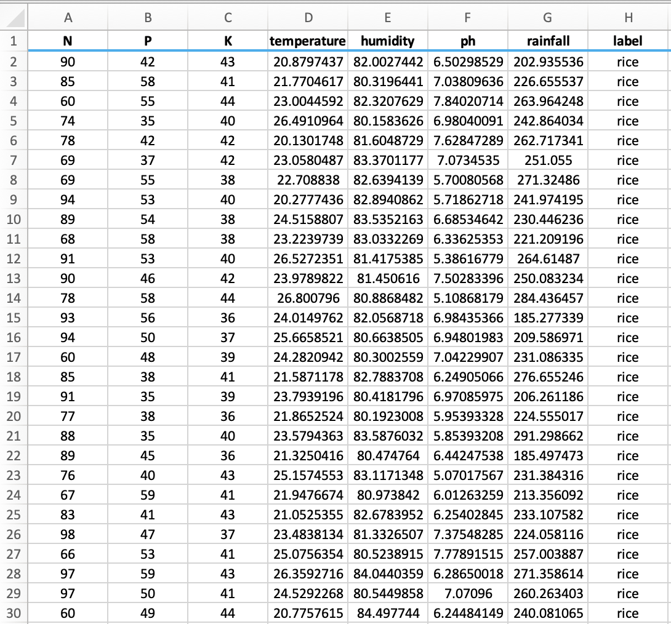
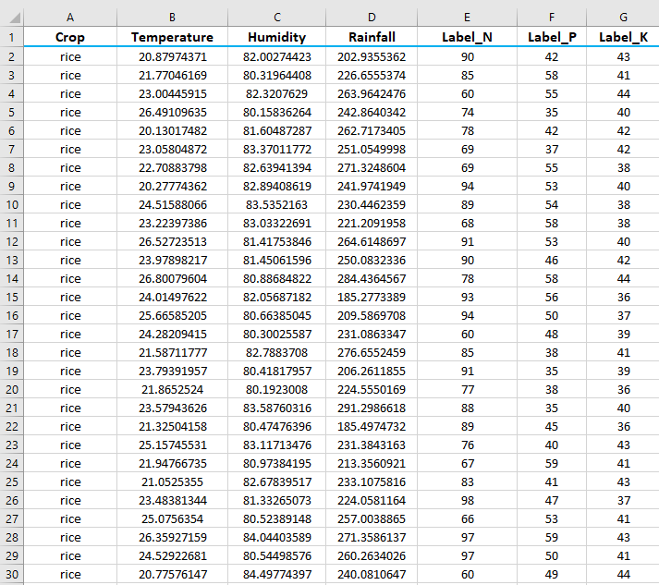
DATA PREPARATION
Actual Dataset :
Actual Dataset contains 8 features. All of the features are not useful for proposed model. Therefore, a dimension reduction technique called feature selection is applied and seven features, then selected for evaluation
Customized Dataset

Slide 18
Data Description
Input Features :
Crop : rice, cotton, etc.
Temperature : temperature in degree Celsius
Humidity : relative humidity in percentage
Rainfall : rainfall in mm
Output Features :
Label_N : ratio of Nitrogen content in soil
Label_P : ratio of Phosphorous content in soil
Label_K : ratio of Potassium content in soil

Slide 19
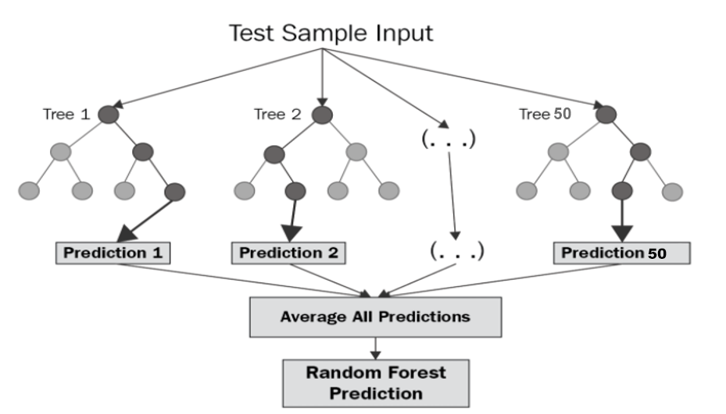
Implementation Algorithm
Random Forest Regression :
Random forest (RF) is a collection of multiple decision trees that have variable hyper-parameters and are trained using varying subsets of data.
In our project, we are going to take crop and location as input, and based on it, we will predict the value of N, P, and K.
First, we will divide our dataset into training and test datasets, where the training dataset is 80% of the original data and the rest 20% is test data.
Then we will create three different random forests of size 50 (decision tree) for each N, P, and K and outputs the mean of the classes as the prediction of all the trees.

Slide 20
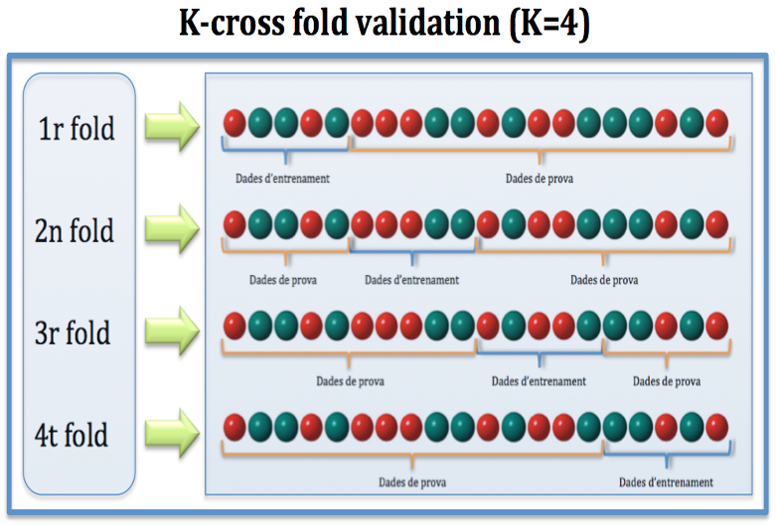
Implementation Algorithm
Cross Validation :
Cross-validation is a resampling technique for testing machine learning models on a small set of data.
The algorithm has only one parameter, k, which determines how many groups a given data sample should be divided into. As a result, k-fold cross-validation is a common name for the procedure.
When a specific number for k is supplied, it can be used in place of k in the model's reference, such as k=4 for 4-fold cross-validation.

Slide 21

Results
Homepage of Harvest Helper

Slide 22


Results
Input Form
Details filled using the drop-down menu

Slide 23
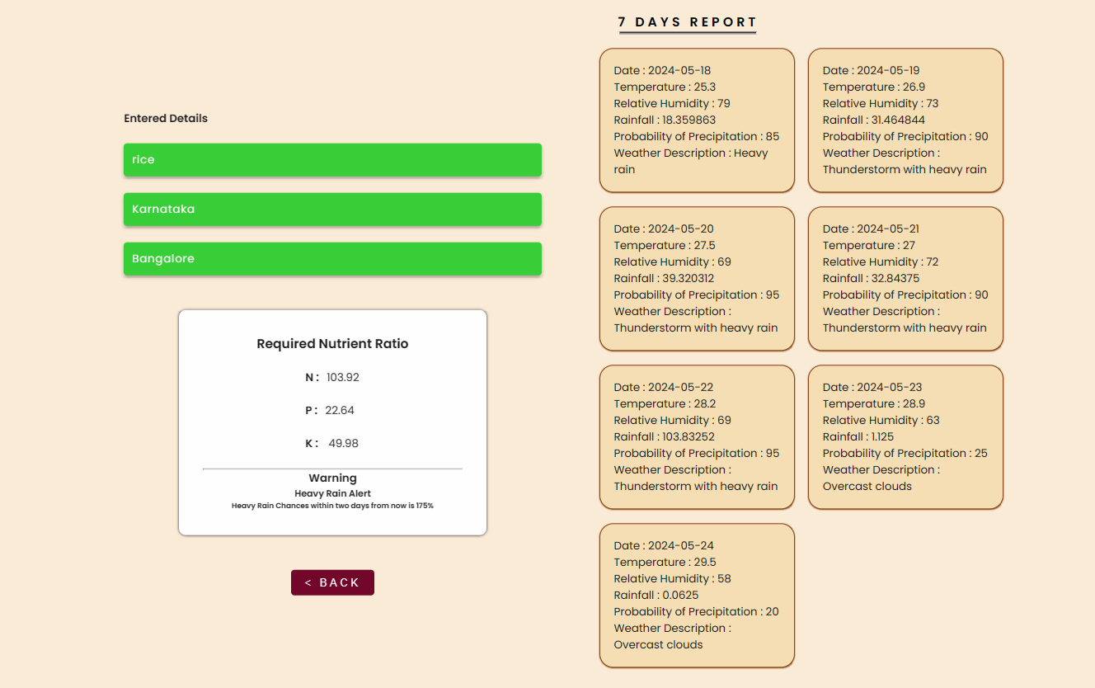

Results
Applying Algorithm to inputted details
Output with seven days of weather forecasts & alerts/messages

Slide 24
Future Scope
Looking ahead, there are several avenues for enhancing and expanding the system. The project can be extended to include a wider variety of crops and incorporate advanced machine learning models for improved prediction accuracy. Integration with Internet of Things (IoT) devices, such as soil sensors and weather stations, can provide real-time, localized data, further refining recommendations. Developing a mobile application and adding support for multiple local languages will increase accessibility for farmers. Additionally, continuous user feedback integration, collaboration with agricultural experts, and economic analysis tools can refine the system to better meet the practical needs of farmers. These enhancements will not only improve the system's effectiveness but also pave the way for more sustainable and productive farming practices.

Slide 25
Conclusion
The project showcased the potential of leveraging data-driven approaches to enhance agricultural productivity and sustainability. By providing precise NPK (Nitrogen, Phosphorus, Potassium) ratios tailored to specific crop needs and environmental conditions, the system can significantly improve crop yields, soil health, and economic returns for farmers. The user-friendly web application ensures accessibility, allowing farmers to make informed decisions about fertilization timing and other agricultural practices. This not only supports sustainable practices but also contributes to national economic growth in India's agriculture sector. The project's success highlights the value of combining historical data with real-time information to create practical solutions for farmers.

Slide 26
References
[1] Krutika Hampannavar,Vijay Bhajantri,Shashikumar G. Totad , “Prediction of Crop Fertilizer Consumption,” Fourth International Conference on Computing Communication Control and Automation (ICCUBEA), 2018, PP. 1-5
[2] G. Prabakaran,D. Vaithiyanathan, Madhavi Ganesan , “Fuzzy decision support system for improving the crop productivity and efficient use of fertilizers ,” Computers and Electronics in Agriculture, vol-150, 2018, PP. 88-97
[3] Shital Bhojani,Nirav Bhatt, “Data Mining Techniques for Crop Yield Prediction,” Computers and Electronics in Agriculture, vol-6, 2018, PP. 357-358
[4] Yulong Yin, Hao Ying,Huifang Zheng ,Qingsong Zhang ,Yanfang Xue,Zhenling Cui , “Estimation of NPK requirements for rice production in diverse Chinese environments under optimal fertilization rates ,” Agricultural and Forest Meteorology, vol-279, 2019, PP. 1-6
[5] Laura J.T. Hess,Eve-Lyn S. Hinckley,G. Philip Robertson,Pamela A. Matson , “Rainfall intensification increases nitrate leaching from tilled but not no-till cropping systems in the U.S. Midwest ,” Agriculture, Ecosystems & Environment, vol-290, 2020, PP. 1-10
[6] Potnuru Sai Nishant,Pinapa Sai Venkat,Bollu Lakshmi Avinash,B. Jabber , “Crop Yield Prediction Based on Indian Agriculture using Machine Learning,” 2020 International Conference for Emerging Technology (INCET), 2020, PP. 1-4
[7] Tony Yang,Kadambot H.M. ,Siddique,Kui Liu , “Cropping systems in agriculture and their impact on soil health ,” Global Ecology and Conservation, vol-23, year, PP. 1-13
[8] János Kátai,Ágnes Oláh Zsuposné,Magdolna Tállai,Tarek Alshaal, “Would fertilization history render the soil microbial communities and their activities more resistant to rainfall fluctuations? ,” Ecotoxicology and Environmental Safety, vol-201, 2020, PP. 1-11
[9] Usman Ahmed,Jerry Chun-Wei Lin, Gautam Srivastava,Youcef Djenouri , “A nutrient recommendation system for soil fertilization based on Evolutionary Computation,” Computers and Electronics in Agriculture, vol-189, 2021, PP. 1-7
[10] A.Hussein , Diogenes L. Antille , Shreevatsa Kodur , GuangnanChen,Jeff N.Tullberg , “Controlled traffic farming effects on productivity of grain sorghum, rainfall and fertiliser nitrogen use efficiency,” Journal of Agriculture and Food Research, vol-3, 2021, PP. 1-17
[11] Zujiao Shi, Donghua Liu, Miao Liu, Muhammad Bilal Hafeez, Pengfei Wen, Xiaoli Wang, Rui Wang, Xudong Zhang, Jun Li , “Optimized fertilizer recommendation method for nitrate residue control in a wheat–maize double cropping system in dryland farming ,” Field Crops Research , vol-271, 2021, PP. 1-10

Slide 27
References
[12] Janmejay Pant, R.P. Pant, Manoj Kumar Singh, Devesh Pratap Singh, Himanshu Pant , “Analysis of agricultural crop yield prediction using statistical techniques of machine learning ,” Materials Today: Proceedings, vol-46, 2021, PP. 1-10
[13] Benny Antony , “Prediction of the production of crops with respect to rainfall.,” Environmental Research, vol-202, 2021, PP. 1-5
[14] Akash Manish Lad, K. Mani Bharathi, B. Akash Saravanan, R. Karthik, “Factors affecting agriculture and estimation of crop yield using supervised learning algorithms ,” Materials Today: Proceedings,, 2022, PP. 1-10
[15] Raves Akhtar, Shabbir Ahmad Sofi, “Precision agriculture using IoT data analytics and machine learning,” Journal of King Saud University - Computer and Information Sciences, 2021, PP. 1-17
[16] Fang-binQIAOJi-kunHUANG, “Farmers' risk preference and fertilizer use,” Journal of Integrative Agriculture,vol-20, PP. 1987-1995
[17] Saheed Garnaik, Prasanna Kumar Samant, Mitali Mandal, Tushar Ranjan Mohanty, Sanat Kumar Dwibedi, Ranjan Kumar Patra, Kiran Kumar Mohapatra, R.H. Wanjari, Debadatta Sethi, Dipaka Ranjan Sena, Tek Bahadur Sapkota, Jagmohan Nayak, Sridhar Patra, Chiter Mal Parihar, Hari Sankar Nayak, “Untangling the effect of soil quality on rice productivity under a 16-years long-term fertilizer experiment using conditional random forest,” Computers and Electronics in Agriculture, vol-197,2022, PP. 1-10
[18] Rubby Aworka, Lontsi Saadio Cedric, Wilfried Yves Hamilton Adoni, Jérémie Thouakesseh Zoueu, Franck Kalala Mutombo, Charles Lebon Mberi Kimpolo, Tarik Nahhal, Moez Krichen, “Agricultural decision system based on advanced machine learning models for yield prediction: Case of East African countries,” Smart Agricultural Technology, vol-3, 2022, PP. 1-9
[19] Senthil Kumar Swami Durai, Mary Divya Shamili, “Smart farming using Machine Learning and Deep Learning techniques,” Decision Analytics Journal, vol-2, 2022, PP. 1-30
[20] M.S. Suchithra, Maya L. Pai, “Improving the prediction accuracy of soil nutrient classification by optimizing extreme learning machine parameters,” Information Processing in Agriculture, vol-7, 2022, PP. 1-11

Slide 28
THANK YOU

